Slide 1
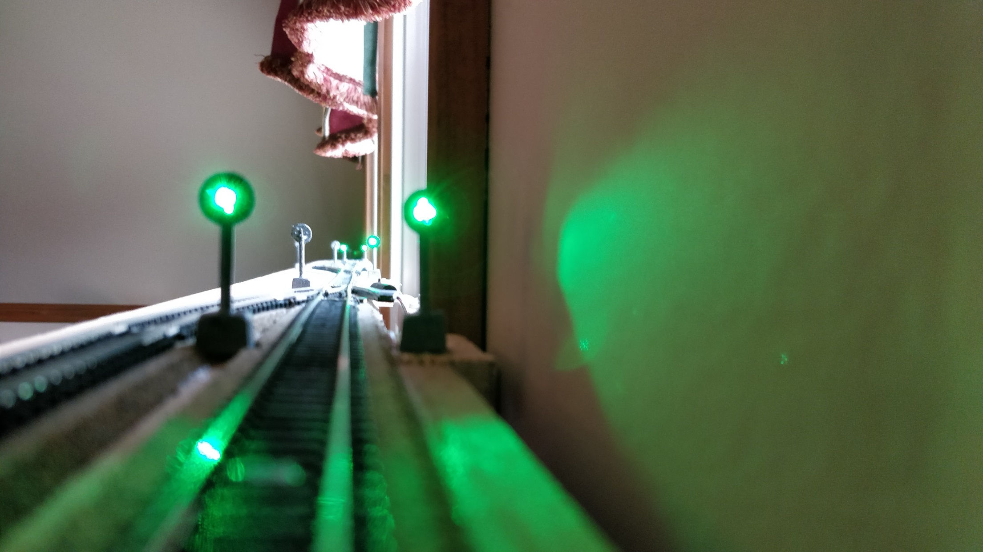
Make your own
Signaling
System

Slide 2
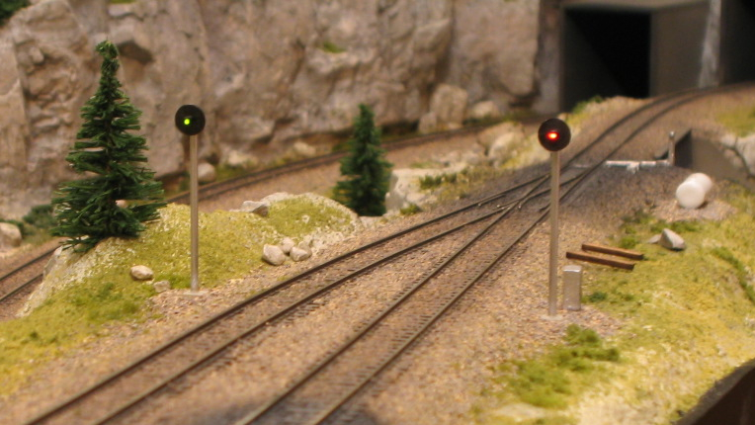
Source: http://nscaleaddiction.blogspot.com/2012/01/cheap-simple-n-scale-signals-using.html

Slide 3
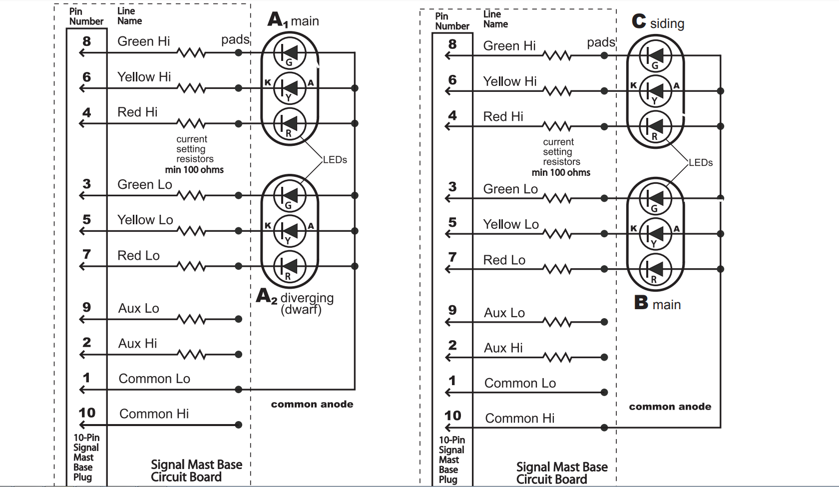
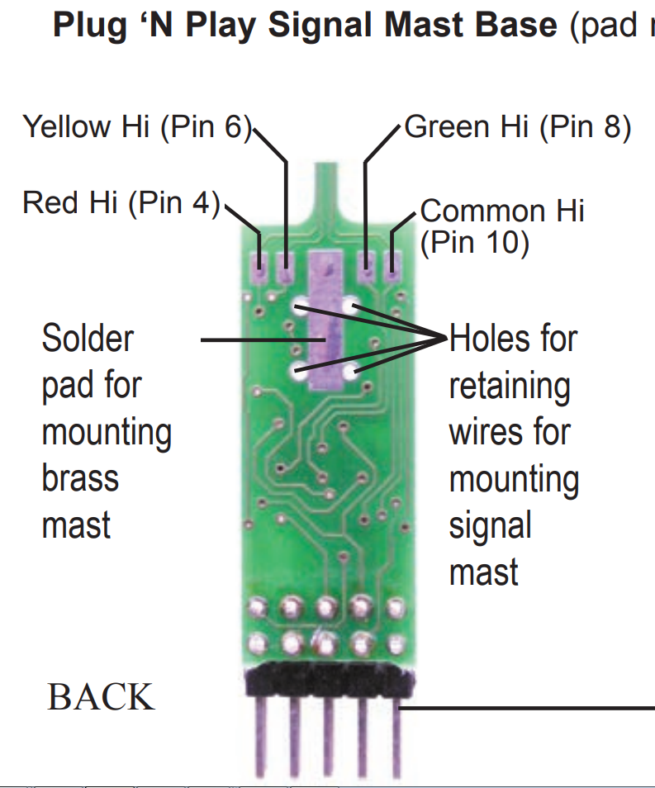

Slide 4
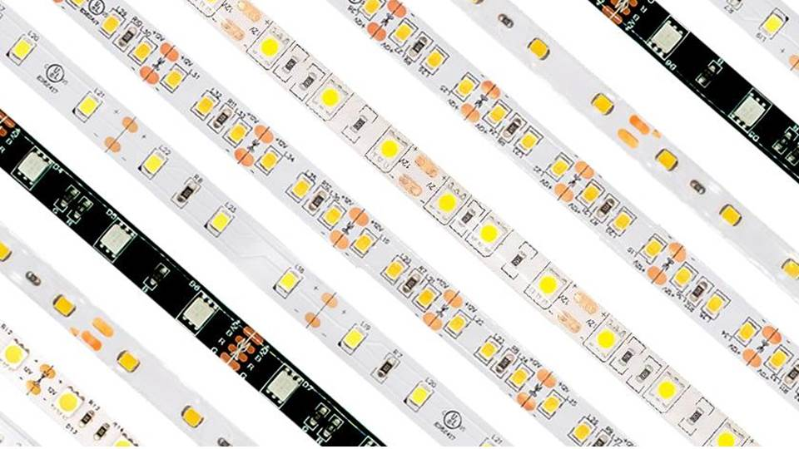

Slide 5
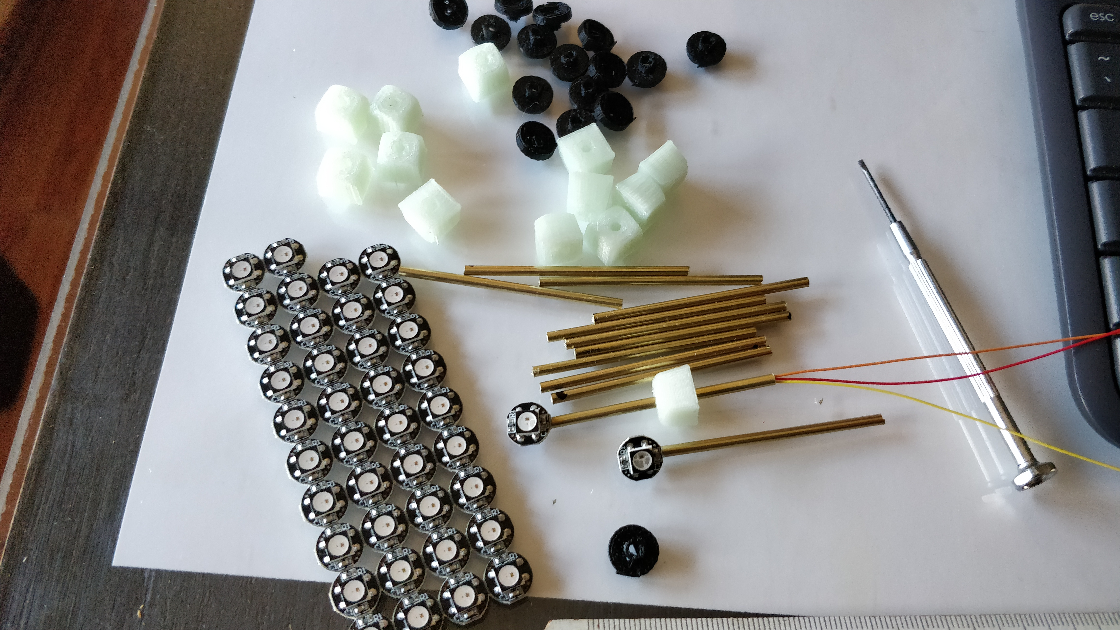

Slide 6
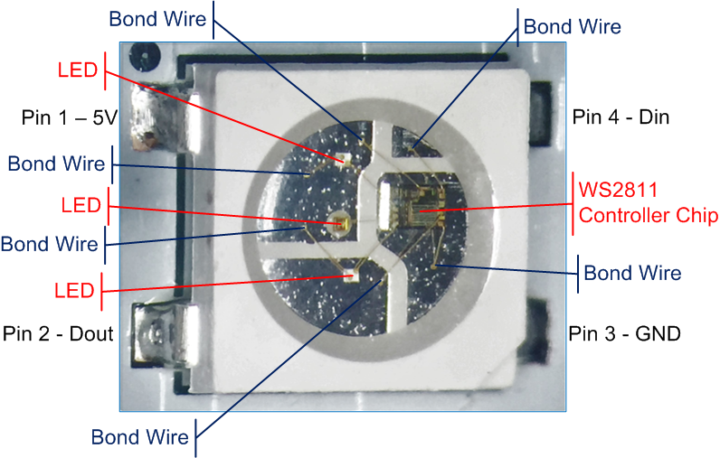
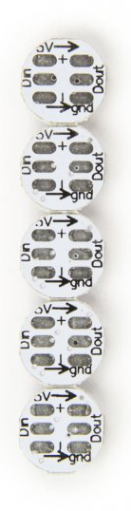
10mm

Slide 7
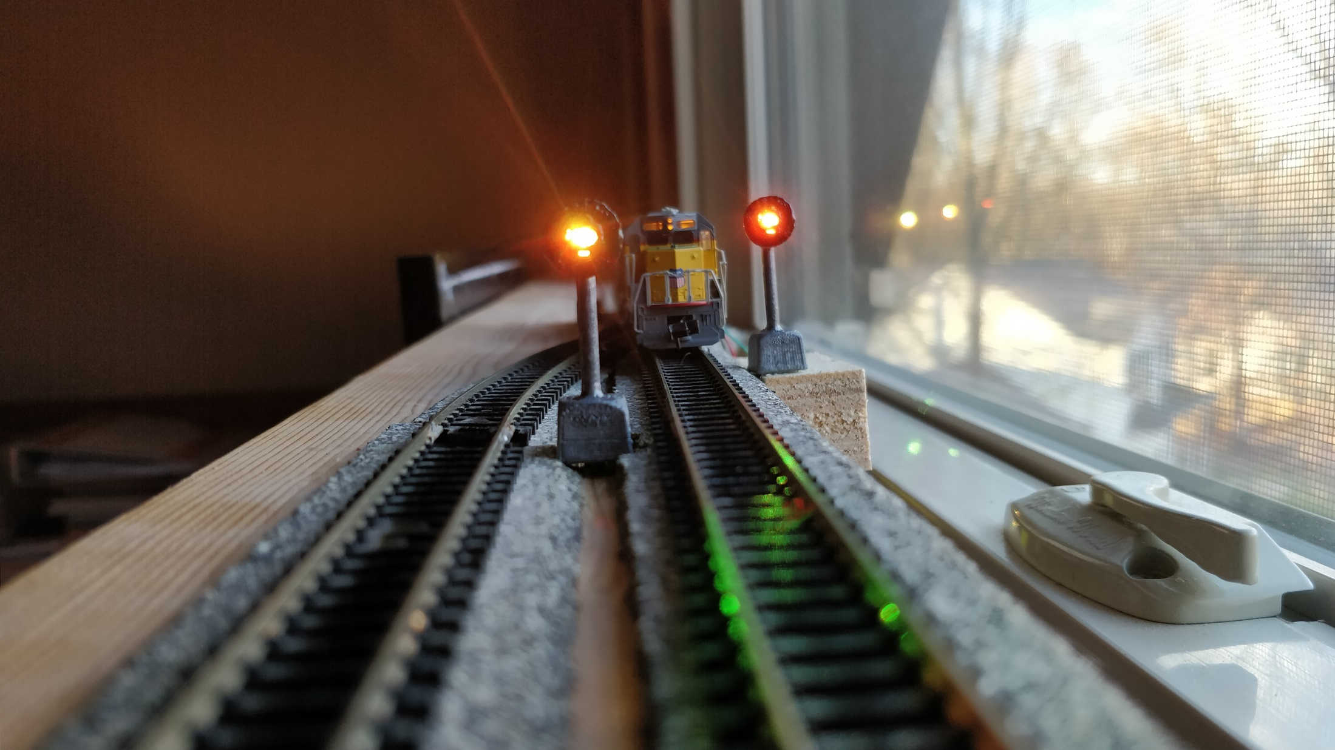
Engineer’s Eye Level

Slide 8
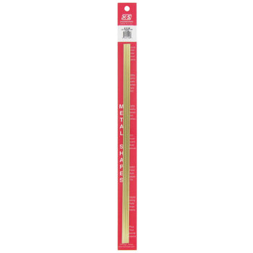
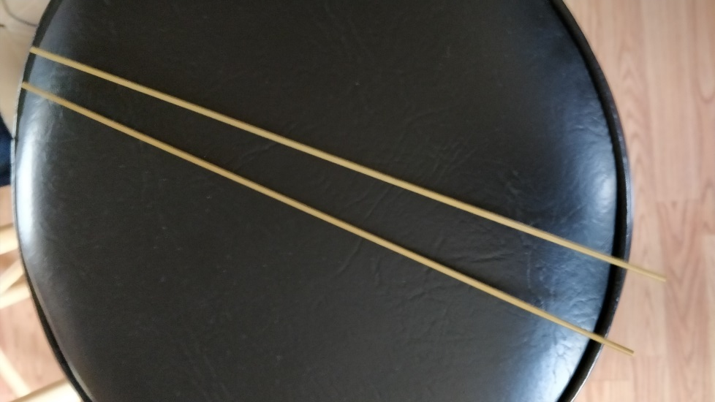
12” long. I needed 2 tubes for the 12 signals I built
From Hobby Lobby:
https://www.hobbylobby.com/Crafts-Hobbies/Hobbies-Collecting/Tools-Blades/Brass-Tubes---3-32%22/p/24129

Slide 10
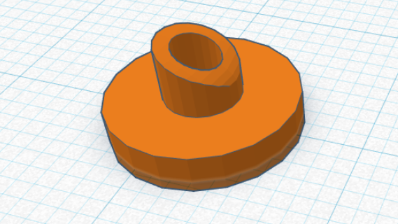
LED Shield
Designed using TinkerCAD (www.tinkercad.com)

Slide 11
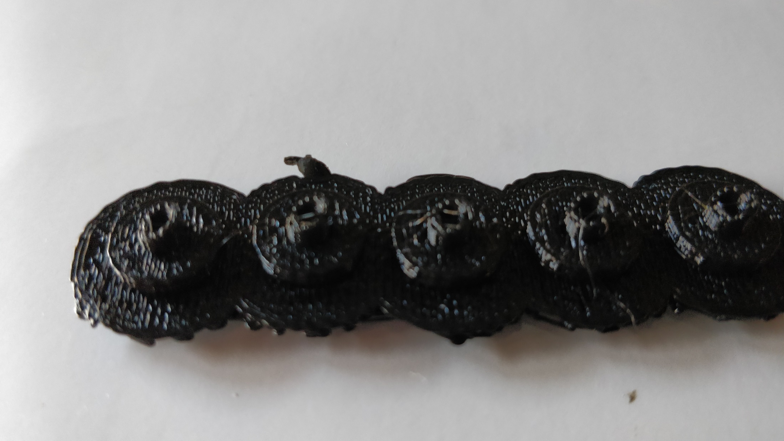

Slide 12
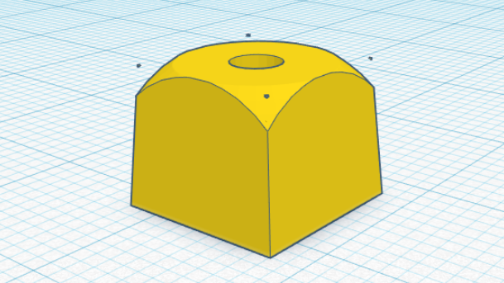
Mast Socket
Designed using TinkerCAD (www.tinkercad.com)

Slide 13


Slide 14
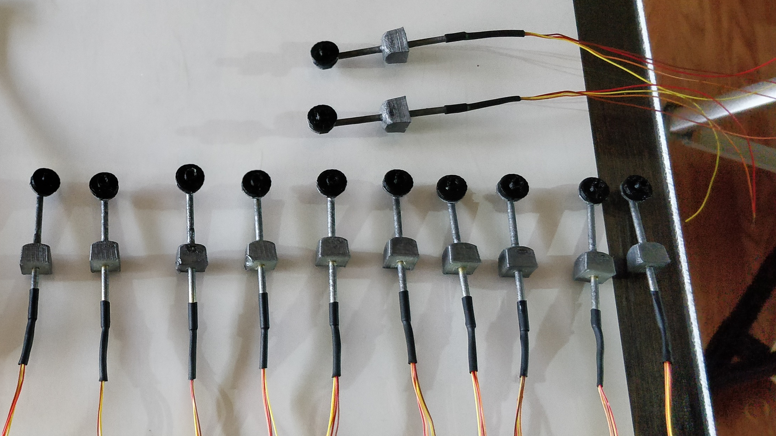

Slide 15
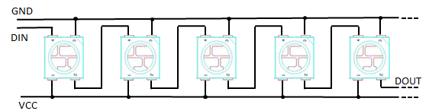
Neopixel Daisy Chain

Slide 16
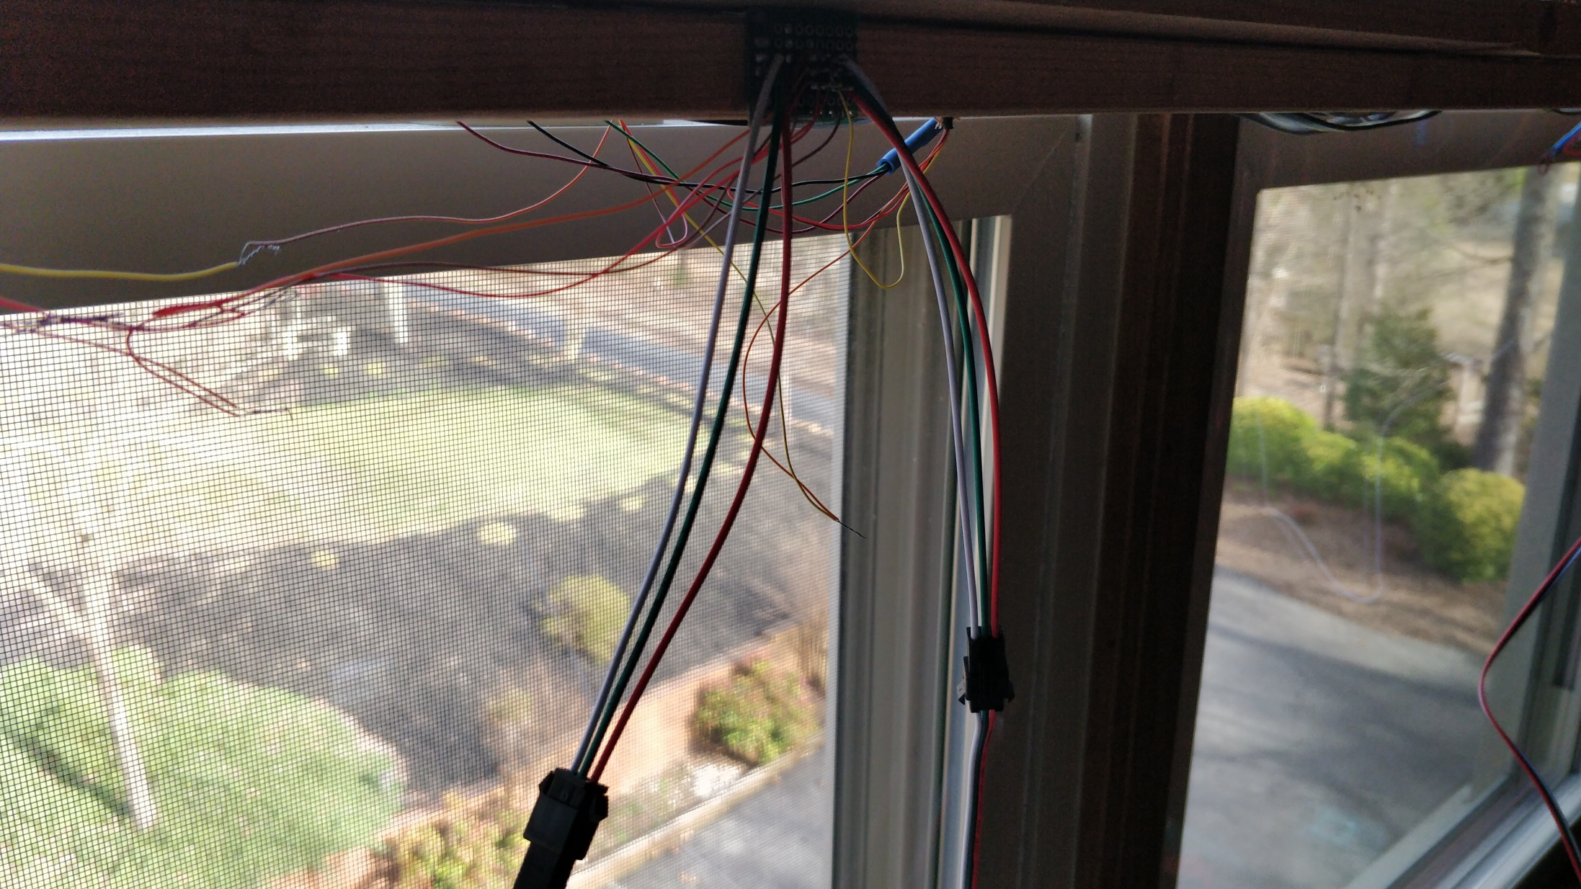

Slide 17
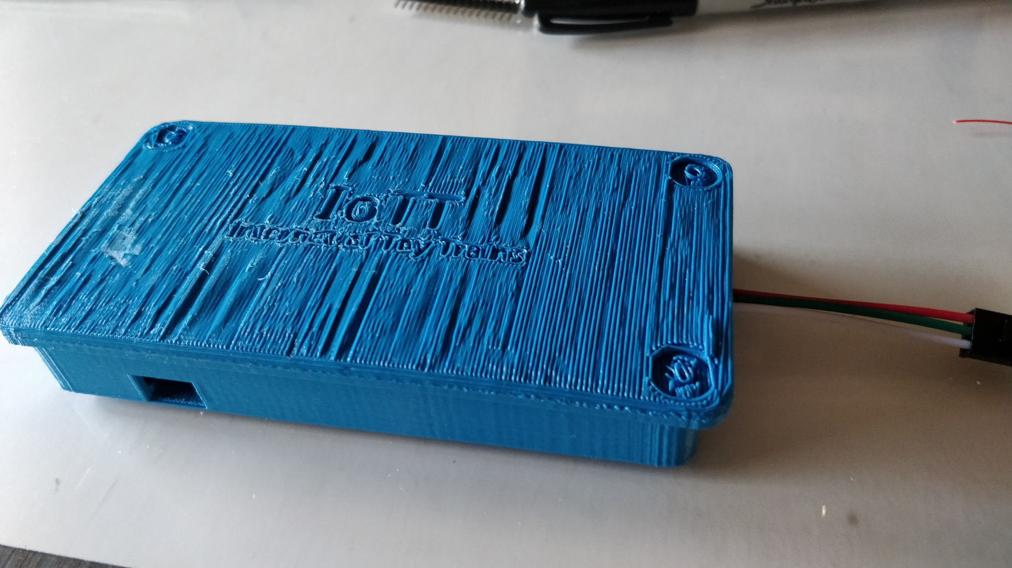

Slide 18
Signal System Capabilities
Number of Signals only limited by device memory. 200+ signals are realistic with just one signaling device

Slide 19
Signal System Capabilities
Number of Signals only limited by device memory. 200+ signals are realistic with just one signaling device
Can receive aspect commands via LocoNet, DCC Track Signal, or Wifi (MQTT Gateway)

Slide 20
Signal System Capabilities
Number of Signals only limited by device memory. 200+ signals are realistic with just one signaling device
Can receive aspect commands via LocoNet, DCC Track Signal, or Wifi (MQTT Gateway)
Supports full range of Switch Addresses as well as Extended Accessory Decoder commands (NMRA Signal commands supporting 36 Aspects)

Slide 21
Signal System Capabilities
Number of Signals only limited by device memory. 200+ signals are realistic with just one signaling device
Can receive aspect commands via LocoNet, DCC Track Signal, or Wifi (MQTT Gateway)
Supports full range of Switch Addresses as well as Extended Accessory Decoder commands (NMRA Signal commands supporting 36 Aspects)
All signals can be different regarding number of LED’s, number of aspects, colors, etc.

Slide 22
Signal System Capabilities
Number of Signals only limited by device memory. 200+ signals are realistic with just one signaling device
Can receive aspect commands via LocoNet, DCC Track Signal, or Wifi (MQTT Gateway)
Supports full range of Switch Addresses as well as Extended Accessory Decoder commands (NMRA Signal commands supporting 36 Aspects)
All signals can be different regarding number of LED’s, number of aspects, colors, etc.
Supports up to 4 switch addresses per signal for a maximum of 16 Aspects in static or 8 Aspects in dynamic mode

Slide 23
Signal System Capabilities
Number of Signals only limited by device memory. 200+ signals are realistic with just one signaling device
Can receive aspect commands via LocoNet, DCC Track Signal, or Wifi (MQTT Gateway)
Supports full range of Switch Addresses as well as Extended Accessory Decoder commands (NMRA Signal commands supporting 36 Aspects)
All signals can be different regarding number of LED’s, number of aspects, colors, etc.
Supports up to 4 switch addresses per signal for a maximum of 16 Aspects in static or 8 Aspects in dynamic mode
Simple 3-wire cable for serial connection chain to all signals

Slide 24
Signal System Capabilities
Number of Signals only limited by device memory. 200+ signals are realistic with just one signaling device
Can receive aspect commands via LocoNet, DCC Track Signal, or Wifi (MQTT Gateway)
Supports full range of Switch Addresses as well as Extended Accessory Decoder commands (NMRA Signal commands supporting 36 Aspects)
All signals can be different regarding number of LED’s, number of aspects, colors, etc.
Supports up to 4 switch addresses per signal for a maximum of 16 Aspects in static or 8 Aspects in dynamic mode
Simple 3-wire cable for serial connection chain to all signals
Graphical user interface with built-in simulator for the design of aspects of each signal, depending on number of lamps on the signal

Slide 25
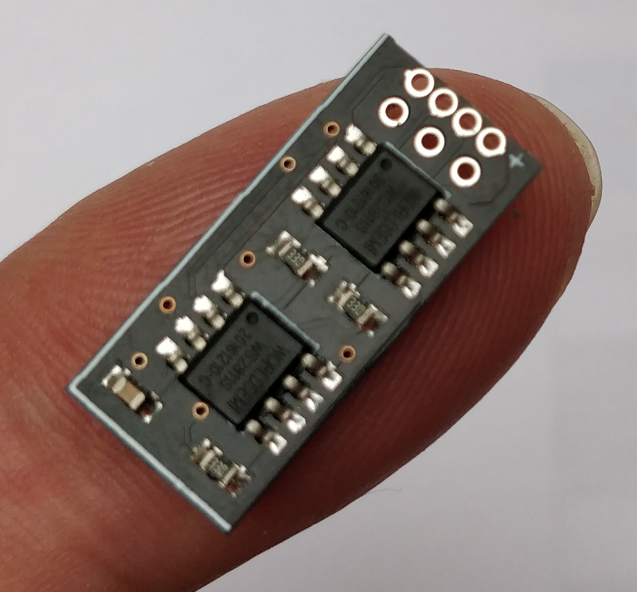
http://www.mollehem.se/index.php/en/control-and-electronics/leddriv6e-detail

Slide 26
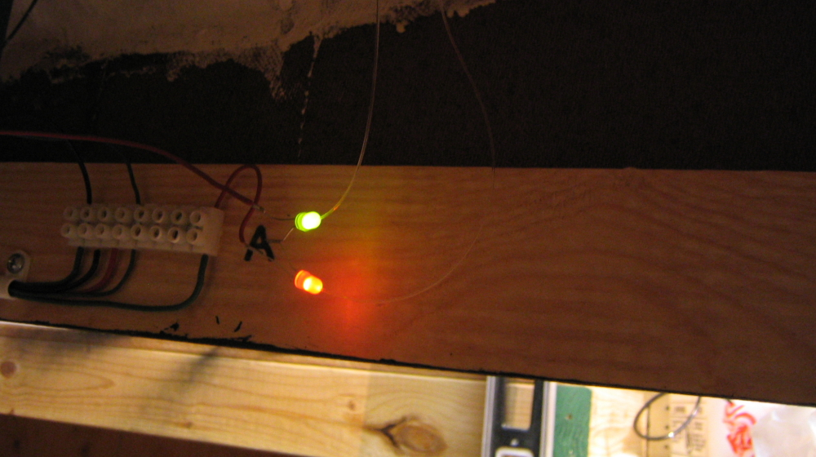
Source:
http://nscaleaddiction.blogspot.com/2012/01/cheap-simple-n-scale-signals-using.html
Optical Fibers to conduct light from LED to signal head

Slide 27
Summary
Signal systems do not have to be complex or expensive. Neopixel LEDs are the way to go

Slide 28
Summary
Signal systems do not have to be complex or expensive. Neopixel LEDs are the way to go
Daisy chaining all signals using just a 3-wire interface is much simpler than using signaling boards that only can support a limited number of signals per board

Slide 29
Summary
Signal systems do not have to be complex or expensive. Neopixel LEDs are the way to go
Daisy chaining all signals using just a 3-wire interface is much simpler than using signaling boards that only can support a limited number of signals per board
Of course, much depends on ease of configurability to make the Blue Box simple to install and use on a layout

Slide 30
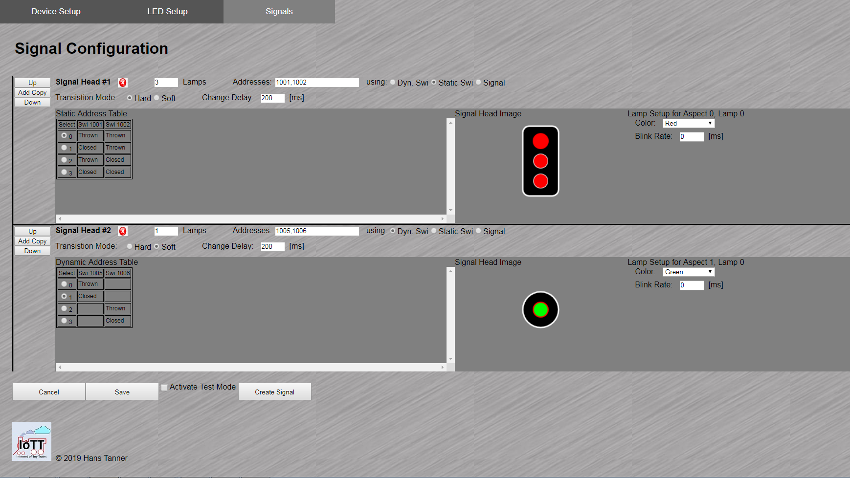

Slide 31
Additional Materials on Github: https://github.com/tanner87661/IoTT-Video13
NA Signal Heads: https://en.wikipedia.org/wiki/North_American_railroad_signals
NORAC Signal Aspects: http://rail.pgengler.net/signals/fixed_norac.html
NMRA 9.2.1 https://www.nmra.org/sites/default/files/s-9.2.1_2012_07.pdf
WS2811 Module: http://www.mollehem.se/index.php/en/control-and-electronics/leddriv6e-detail
Fibre Optics Signals: http://nscaleaddiction.blogspot.com/2012/01/cheap-simple-n-scale-signals-using.html
Layout Intro Sequence Outdoor Layout: Beat Deola, Switzerland​

